Slide 1
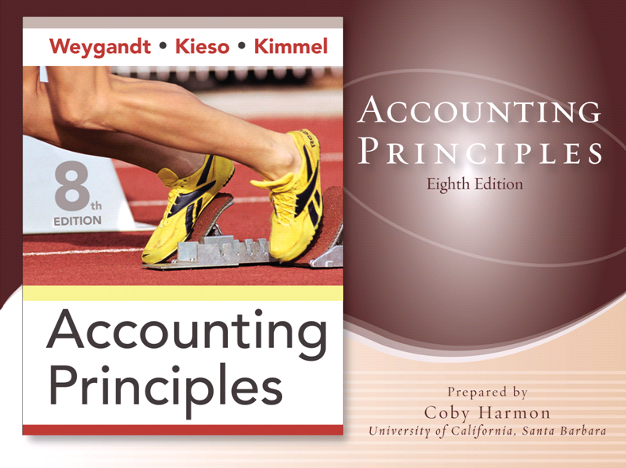

Slide 2
CHAPTER 4
COMPLETING THE
ACCOUNTING CYCLE
Accounting Principles, Eighth Edition

Slide 3
Study Objectives
Prepare a worksheet.
Explain the process of closing the books.
Describe the content and purpose of a post-closing trial balance.
State the required steps in the accounting cycle.
Explain the approaches to preparing correcting entries.
Identify the sections of a classified balance sheet.
Notes:
1. On the topic, “Challenges Facing Financial Accounting,” what did the AICPA Special Committee on Financial Reporting suggest should be included in future financial statements?
Non-financial Measurements (customer satisfaction indexes, backlog information, and reject rates on goods purchases).
Forward-looking Information
Soft Assets (a company’s know-how, market dominance, marketing setup, well-trained employees, and brand image).
Timeliness (no real time financial information)

Slide 4

Completing the Accounting Cycle
Using a Worksheet
Closing the Books
Summary of Accounting Cycle
Classified Balance Sheet
Steps in preparation
Preparing financial statements
Preparing adjusting entries
Preparing closing entries
Posting closing entries
Preparing a post-closing trial balance
Reversing entries—An optional step
Correcting entries—An avoidable step
Current assets
Long-term investments
Property, plant, and equipment
Intangible assets
Current liabilities
Long-term liabilities
Owner’s equity
Notes:
Service Cost - Actuaries compute service cost as the present value of the new benefits earned by employees during the year. Future salary levels considered in calculation.
Interest on Liability - Interest accrues each year on the PBO just as it does on any discounted debt.
Actual Return on Plan Assets - Increase in pension funds from interest, dividends, and realized and unrealized changes in the fair market value of the plan assets.
Amortization of Unrecognized Prior Service Cost - The cost of providing retroactive benefits is allocated to pension expense in the future, specifically to the remaining service-years of the affected employees.
Gain or Loss - Volatility in pension expense can be caused by sudden and large changes in the market value of plan assets and by changes in the projected benefit obligation. Two items comprise the gain or loss:
difference between the actual return and the expected return on plan assets and,
amortization of the unrecognized net gain or loss from previous periods

Slide 5

Using A Worksheet
Worksheet
A multiple-column form used in preparing financial statements.
Not a permanent accounting record.
Five step process.
Use of worksheet is optional.
LO 1 Prepare a worksheet.

Slide 6
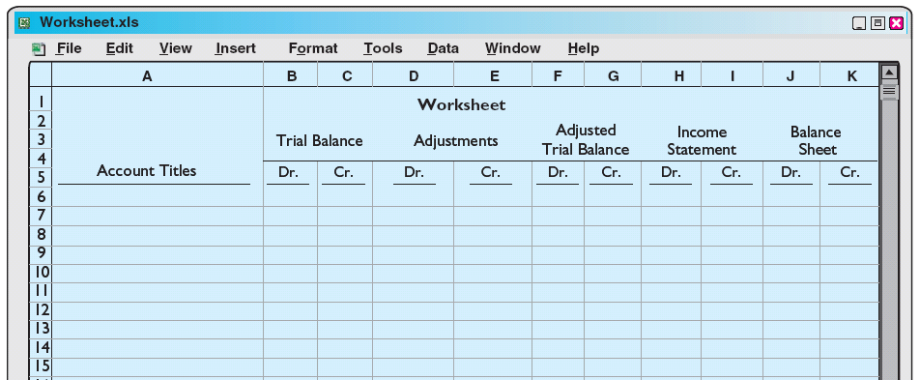
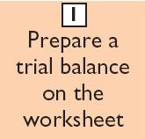
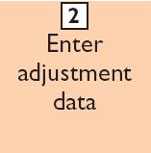
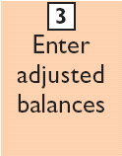
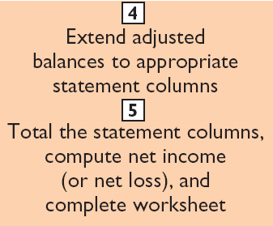
Steps in Preparing a Worksheet
Illustration 4-2
LO 1 Prepare a worksheet.

Slide 7
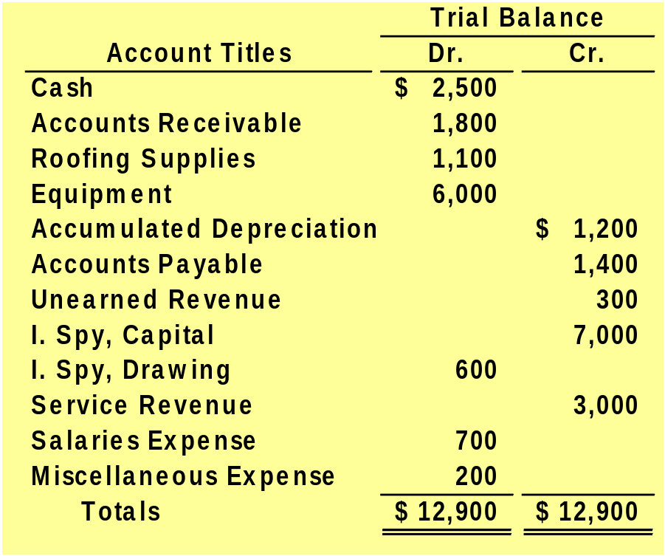
Steps in Preparing a Worksheet
Example
The trial balance for Undercover Roofing for the month ended March 31, 2008, is as follows.
Other data:
1. Supplies on hand total $140.
2. Depreciation for March is $200.
3. Unearned revenue amounted to $130 on March 31.
4. Accrued salaries are $350.
Instructions
a. Prepare and complete the worksheet.
LO 1 Prepare a worksheet.

Slide 8
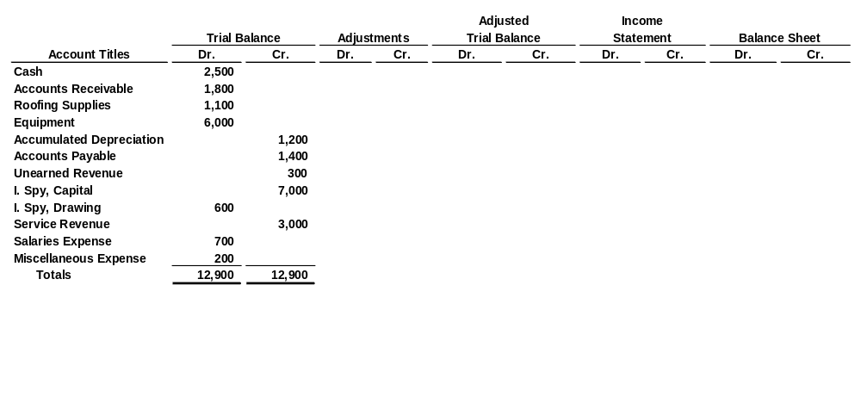
Steps in Preparing a Worksheet
1. Prepare a Trial Balance on the Worksheet
Trial balance amounts come directly from ledger accounts.
Include all accounts with balances.
LO 1 Prepare a worksheet.

Slide 9
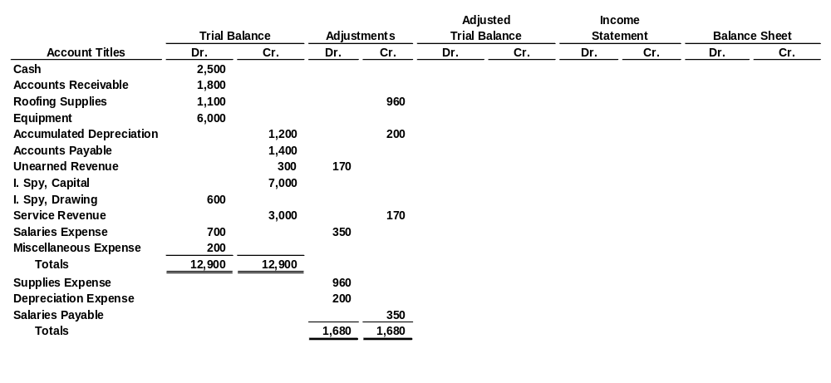
Steps in Preparing a Worksheet
2. Enter the Adjustments in the Adjustments Columns
(a)
Adjustments Key:
(a) Supplies used.
(b) Depreciation expense.
(c) Service revenue earned.
(d) Salaries accrued.
(b)
(c)
(c)
(d)
(a)
(b)
(d)
Enter adjustment amounts, total adjustments columns,
and check for equality.
Add additional accounts as needed.
LO 1 Prepare a worksheet.

Slide 10
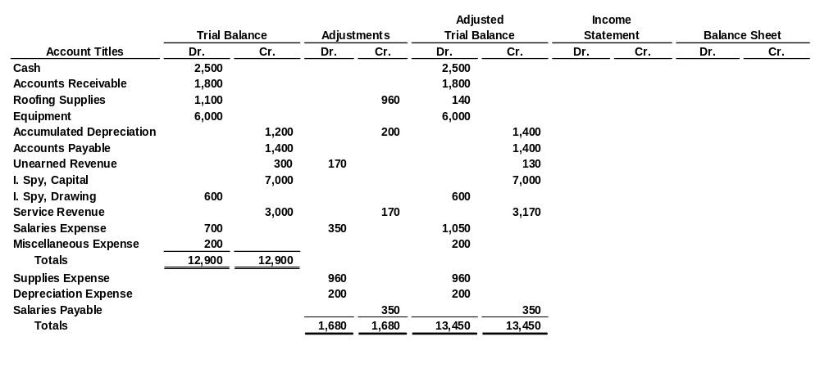
Steps in Preparing a Worksheet
3. Complete the Adjusted Trial Balance Columns
(a)
(b)
(c)
(c)
(d)
(a)
(b)
(d)
Total the adjusted trial balance columns and check for equality.
LO 1 Prepare a worksheet.

Slide 11
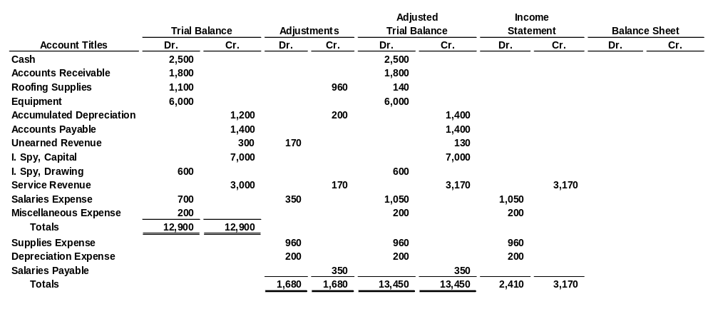
Steps in Preparing a Worksheet
4. Extend Amounts to Financial Statement Columns
(a)
(b)
(c)
(c)
(d)
(a)
(b)
(d)
Extend all revenue and expense account balances to the income statement columns.
LO 1 Prepare a worksheet.

Slide 12
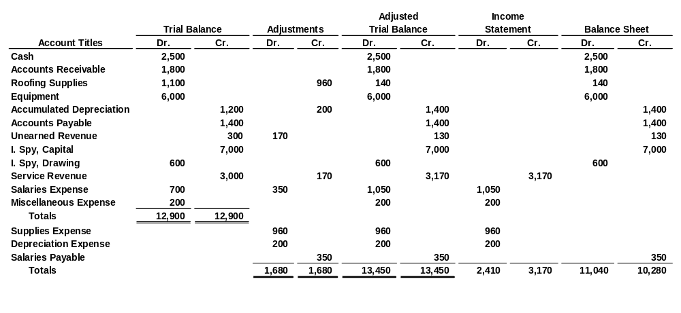
Steps in Preparing a Worksheet
4. Extend Amounts to Financial Statement Columns
(a)
(b)
(c)
(c)
(d)
(a)
(b)
(d)
Extend all asset, liability, and equity account balances to the balance sheet columns.
LO 1 Prepare a worksheet.

Slide 13
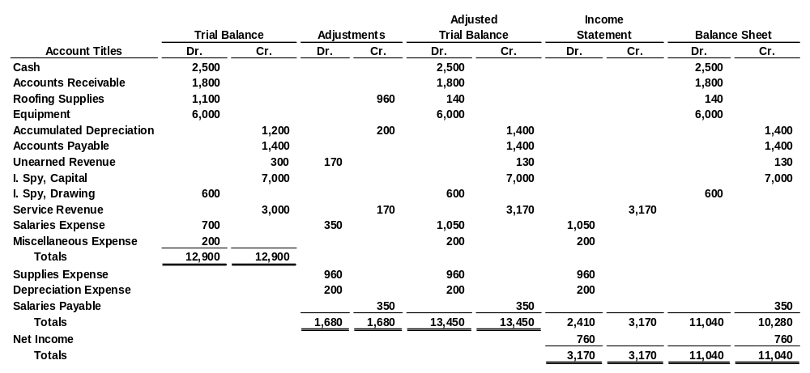
Steps in Preparing a Worksheet
5. Total Columns, Compute Net Income (Loss)
(a)
(b)
(c)
(c)
(d)
(a)
(b)
(d)
Compute Net Income or Net Loss.
LO 1 Prepare a worksheet.

Slide 14
Steps in Preparing a Worksheet
Review Question
Net income is shown on a work sheet in the:
  income statement debit column only.
  balance sheet debit column only.
  income statement credit column and balance sheet debit column.
  income statement debit column and balance sheet credit column.
LO 1 Prepare a worksheet.

Slide 15
Preparing Financial Statements from a Worksheet
Worksheet
  Income statement is prepared from the income statement columns.
  Balance sheet and owner’s equity statement are prepared from the balance sheet columns.
Companies journalize and post adjusting entries.
LO 1 Prepare a worksheet.

Slide 16
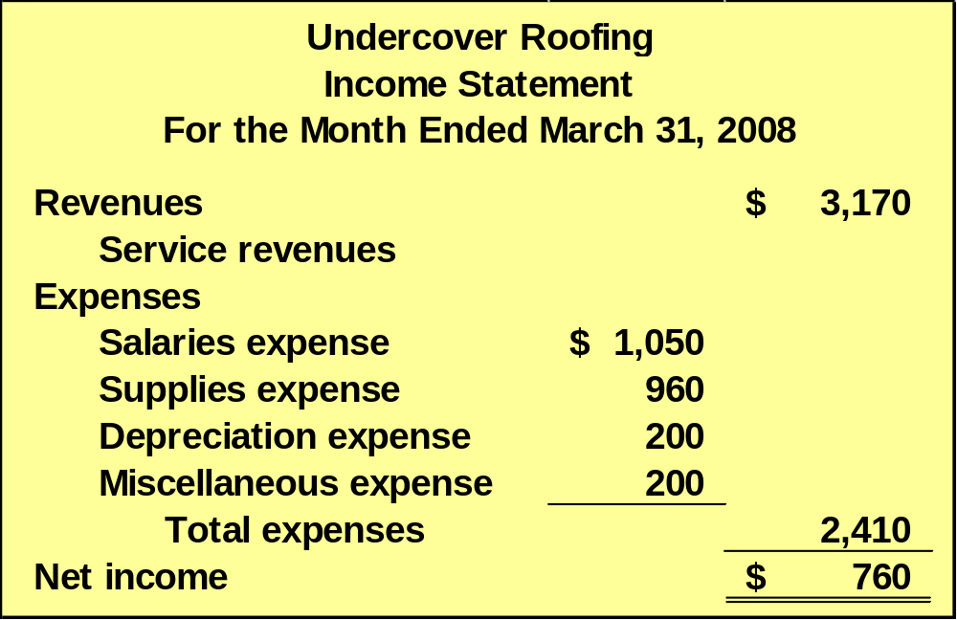
Preparing Financial Statements from a Worksheet
b. Prepare an income statement for the month ended March 31, 2008.
LO 1 Prepare a worksheet.

Slide 17
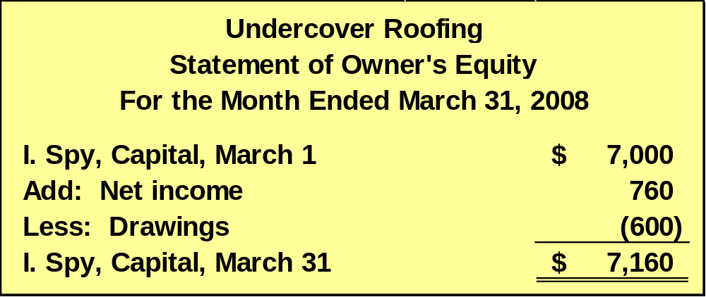
Preparing Financial Statements from a Worksheet
b. Prepare an owner’s equity statement for the month ended March 31, 2008.
LO 1 Prepare a worksheet.

Slide 18
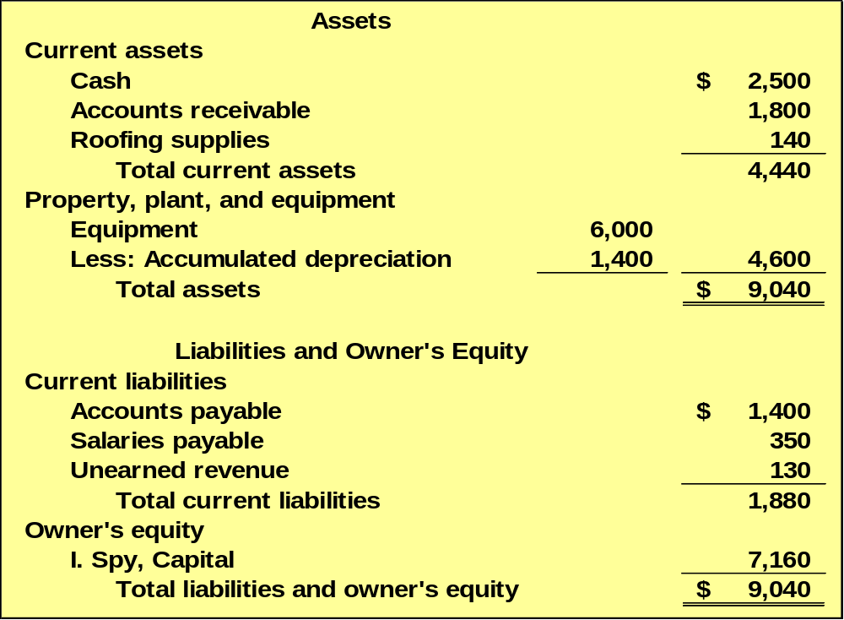
Preparing Financial Statements from a Worksheet
b. Prepare a balance sheet as of March 31, 2008.
Undercover Roofing
Balance Sheet
March 31, 2008
LO 1 Prepare a worksheet.

Slide 19
Preparing Adjusting Entries from a Worksheet
Adjusting Entries
  The adjusting entries are prepared from the adjustments columns of the worksheet.
  Journalizing and posting of adjusting entries follows the preparation of financial statements when a worksheet is used.
LO 1 Prepare a worksheet.

Slide 20
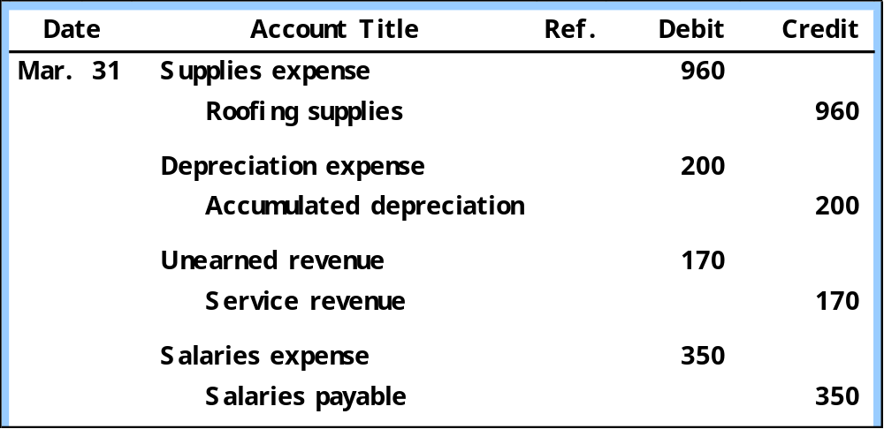
Preparing Financial Statements from a Worksheet
c. Journalize the adjusting entries from the adjustments columns of the worksheet.
LO 1 Prepare a worksheet.

Slide 21
Preparing Financial Statements from a Worksheet
Discussion Question
Q4-2. Explain the purpose of the worksheet.
See notes page for discussion
LO 1 Prepare a worksheet.
Notes:
Question 4-2 (textbook)
2. The work sheet is merely a device used to make it easier to prepare adjusting entries and the financial statements.

Slide 22
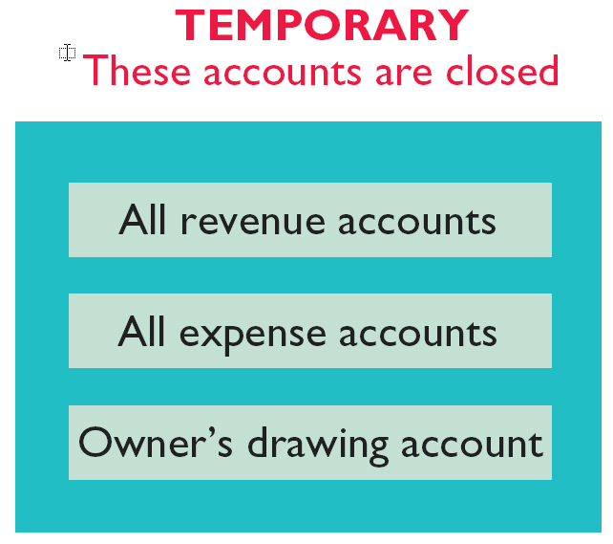
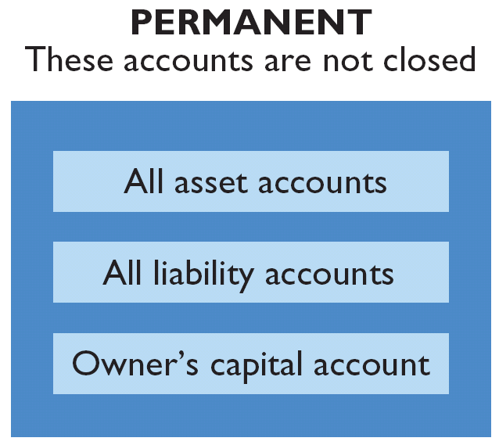
Closing the Books
At the end of the accounting period, the company makes the accounts ready for the next period.
Illustration 4-5
LO 2 Explain the process of closing the books.

Slide 23
Closing the Books
Closing entries formally recognize, in the general ledger, the transfer of
  net income (or net loss) and
  owner’s drawing
  to owner’s capital.
Closing entries are only at the end of the annual accounting period.
LO 2 Explain the process of closing the books.

Slide 24
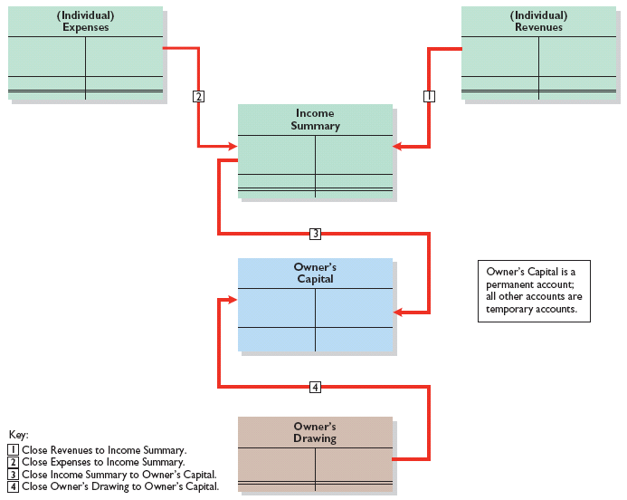
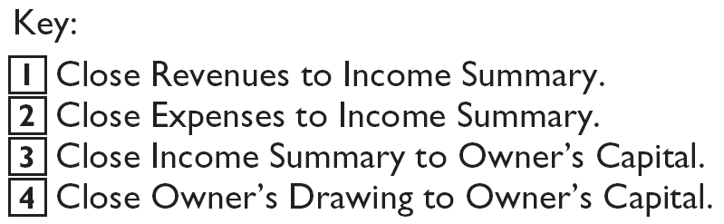
Closing the Books
Note:
Owner’s Drawing is closed directly to Capital and not to Income Summary because Owner’s Drawing is not an expense.
Illustration 4-6
Owner’s Capital is a permanent account; all other accounts are temporary accounts.
LO 2 Explain the process of closing the books.

Slide 25
Closing the Books
d. Journalize the closing entries from the financial statement columns of the worksheet.
Service revenue 3,170
Income summary 3,170
Income summary 2,410
Closing Entries need to be Posted
Salary expense 1,050
Supplies expense 960
Depreciation expense 200
Miscellaneous expense 200
Income summary 760
I. Spy, Capital 760
I. Spy, Capital 600
I. Spy, Drawing 600
LO 2 Explain the process of closing the books.

Slide 26
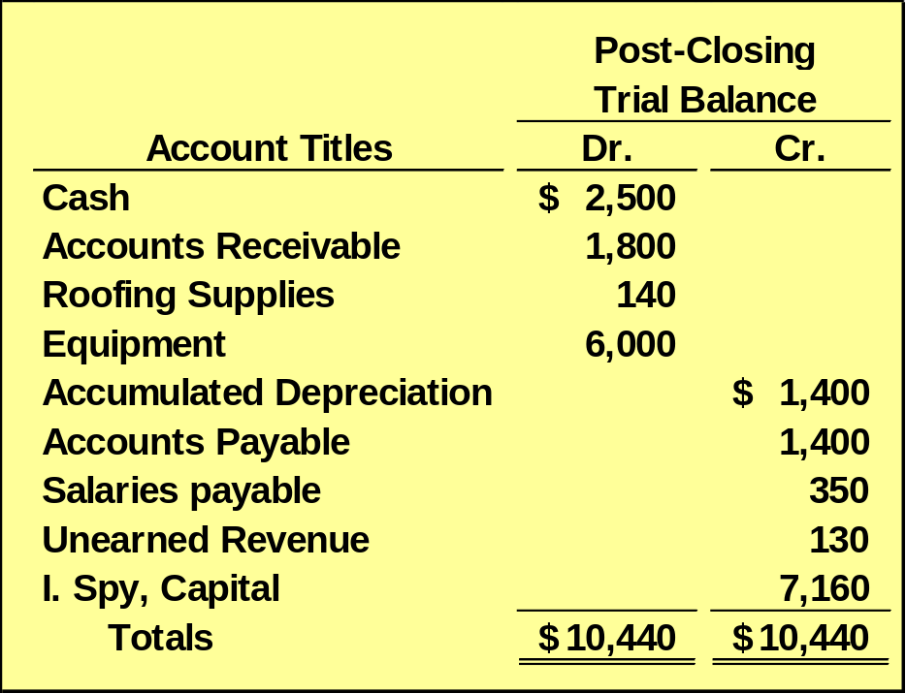
Preparing a Post-Closing Trial Balance
Purpose is to prove the equality of the permanent account balances after journalizing and posting of closing entries.
All temporary accounts will have zero balances.
LO 3 Describe the content and purpose of a post-closing trial balance.

Slide 27
Summary of the Accounting Cycle
Illustration 4-12
1. Analyze business transactions
9. Prepare a post-closing trial balance
2. Journalize the transactions
8. Journalize and post closing entries
3. Post to ledger accounts
7. Prepare financial statements
4. Prepare a trial balance
6. Prepare an adjusted trial balance
5. Journalize and post adjusting entries
LO 4 State the required steps in the accounting cycle.

Slide 28
Correcting Entries—An Avoidable Step
Correcting entries
  are unnecessary if the records are error-free.
  are made whenever an error is discovered.
  must be posted before closing entries.
Instead of preparing a correcting entry, it is possible to reverse the incorrect entry and then prepare the correct entry.
LO 5 Explain the approaches to preparing correcting entries.

Slide 29
Correcting Entries—An Avoidable Step
BE4-9 At Batavia Company, the following errors were discovered after the transactions had been journalized and posted. Prepare the correcting entries.
1. A collection on account from a customer was recorded as a debit to Cash and a credit to Service Revenue for $780.
Incorrect entry
Cash 780
Service revenue 780
Correct entry
Cash 780
Accounts receivable 780
Correcting entry
Service revenue 780
Accounts receivable 780
LO 5 Explain the approaches to preparing correcting entries.

Slide 30
Correcting Entries—An Avoidable Step
BE4-9 At Batavia Company, the following errors were discovered after the transactions had been journalized and posted. Prepare the correcting entries.
2. The purchase of supplies on account for $1,570 was recorded as a debit to Store Supplies and a credit to Accounts Payable for $1,750.
Incorrect entry
Store Supplies 1,750
Accounts payable 1,750
Correct entry
Store Supplies 1,570
Accounts payable 1,570
Correcting entry
Accounts payable 180
Store Supplies 180
LO 5 Explain the approaches to preparing correcting entries.

Slide 31
The Classified Balance Sheet
  Presents a snapshot at a point in time.
  To improve understanding, companies group similar assets and similar liabilities together.
Standard Classifications
Illustration 4-17
Assets Liabilities and Owner’s Equity
Current assets Current liabilities
Long-term investments Long-term liabilities
Property, plant, and equipment Owner’s equity
Intangible assets
LO 6 Identify the sections of a classified balance sheet.

Slide 32
The Classified Balance Sheet
Current Assets
  Assets that a company expects to convert to cash or use up within one year or the operating cycle, whichever is longer.
  Operating cycle is the average time it takes from the purchase of inventory to the collection of cash from customers.
LO 6 Identify the sections of a classified balance sheet.

Slide 33
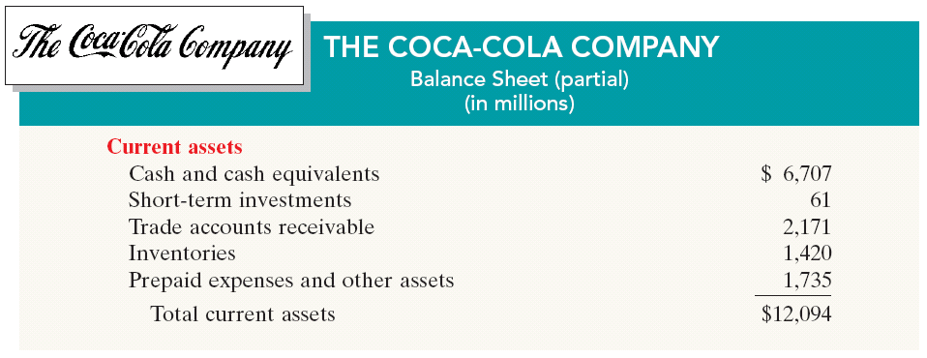
The Classified Balance Sheet
Current Assets
Illustration 4-19
  Companies usually list current asset accounts in the order they expect to convert them into cash.
LO 6 Identify the sections of a classified balance sheet.

Slide 34
The Classified Balance Sheet
Review Question
Cash, and other resources that are reasonably expected to be realized in cash or sold or consumed in the business within one year or the operating cycle, are called:
  Current assets.
  Intangible assets.
  Long-term investments.
  Property, plant, and equipment.
LO 6 Identify the sections of a classified balance sheet.

Slide 35

The Classified Balance Sheet
Long-Term Investments
  Investments in stocks and bonds of other companies.
  Investments in long-term assets such as land or buildings that a company is not currently using in its operating activities.
Illustration 4-20
LO 6 Identify the sections of a classified balance sheet.

Slide 36
The Classified Balance Sheet
Property, Plant, and Equipment
  Long useful lives.
  Currently used in operations.
  Depreciation - allocating the cost of assets to a number of years.
  Accumulated depreciation - total amount of depreciation expensed thus far in the asset’s life.
LO 6 Identify the sections of a classified balance sheet.

Slide 37

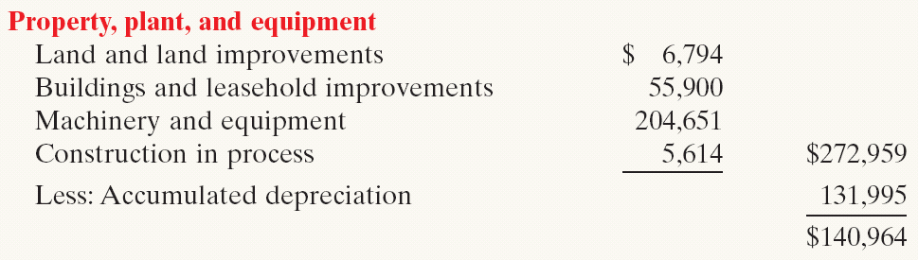
The Classified Balance Sheet
Property, Plant, and Equipment
Illustration 4-21
LO 6 Identify the sections of a classified balance sheet.

Slide 38

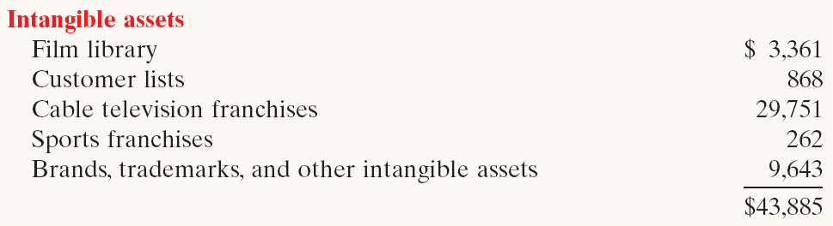
The Classified Balance Sheet
Intangible Assets
  Assets that do not have physical substance.
Illustration 4-22
LO 6 Identify the sections of a classified balance sheet.

Slide 39
The Classified Balance Sheet
Review Question
Patents and copyrights are
  Current assets.
  Intangible assets.
  Long-term investments.
  Property, plant, and equipment.
LO 6 Identify the sections of a classified balance sheet.

Slide 40
The Classified Balance Sheet
Current Liabilities
  Obligations the company is to pay within the coming year.
  Usually list notes payable first, followed by accounts payable. Other items follow in order of magnitude.
  Liquidity - ability to pay obligations expected to be due within the next year.
LO 6 Identify the sections of a classified balance sheet.

Slide 41

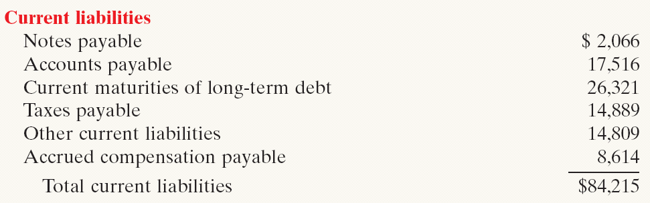
The Classified Balance Sheet
Current Liabilities
Illustration 4-23
LO 6 Identify the sections of a classified balance sheet.

Slide 42

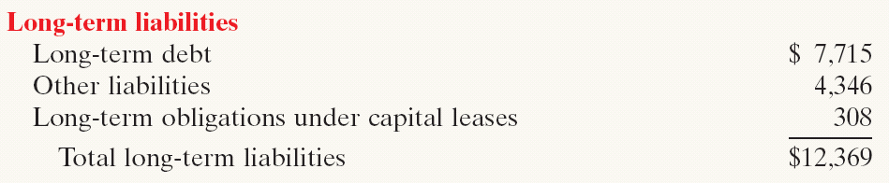
The Classified Balance Sheet
Long-Term Liabilities
  Obligations a company expects to pay after one year.
Illustration 4-24
LO 6 Identify the sections of a classified balance sheet.

Slide 43
The Classified Balance Sheet
Review Question
Which of the following is not a long-term liability?
  Bonds payable
  Current maturities of long-term obligations
  Long-term notes payable
  Mortgages payable
LO 6 Identify the sections of a classified balance sheet.

Slide 44
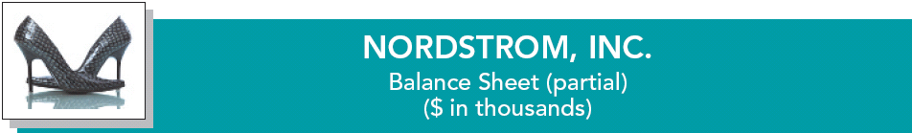
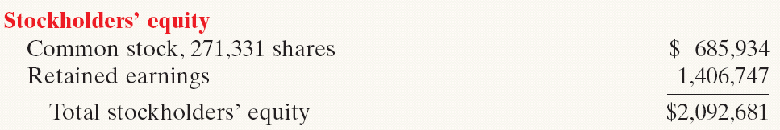
The Classified Balance Sheet
Owner’s Equity
  Proprietorship - one capital account.
  Partnership - capital account for each partner.
  Corporation - Capital Stock and Retained Earnings.
Illustration 4-25
LO 6 Identify the sections of a classified balance sheet.

